Slide 1
Active Audio Cancellation of Electronically Amplified Sound
By: Shubh Tandon
Mentor: Larry Pearlstein
Mentored Undergraduate Summer Experience 2015
Department of Electrical and Computer Engineering

Slide 2
Objective
Notes:
The Objective of this project this summer was to cancel out a sin wave using Adaptive Noise Cancellation

Slide 3
System Architecture

Slide 4
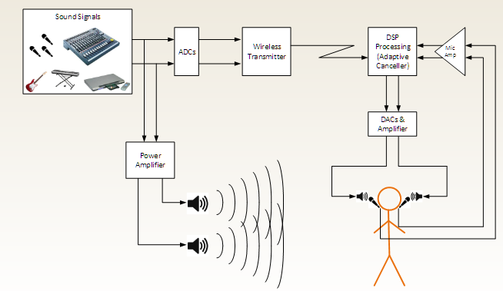
System Model
System Architecture

Slide 5
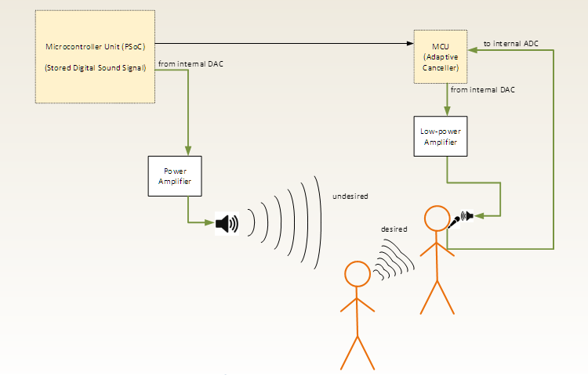
System Built
System Architecture
Notes:
Show HS and LS model

Slide 6
Microphone

Slide 7
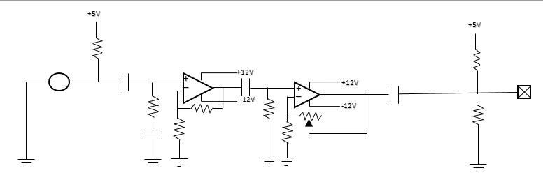
Circuit
Microphone
Pre amplifier for the microphone
Used to increase the gain
Potentiometer fixed in order to adjust the gain if needed
Notes:
Point out that there are several coupling capacitors and some filters

Slide 8
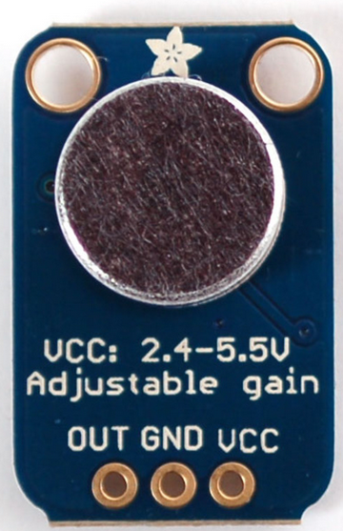
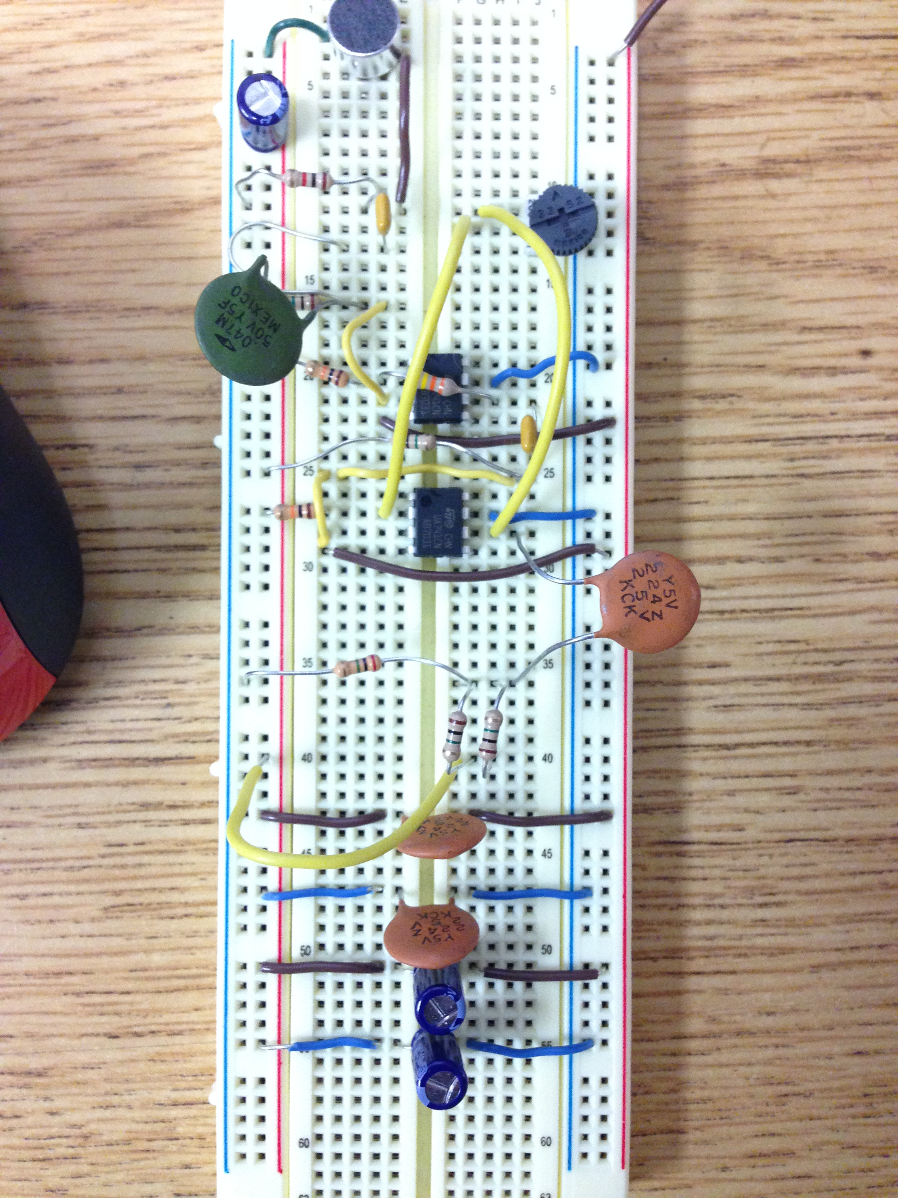
Microphone Specs
Microphone
O
Excellent power supply noise rejection
Delivers a 200kHz gain bandwidth
Open loop gain =125dB
Rail to Rail output
Low-cost microphone
Notes:
Rail to rail - can output all the way to the +/- supply voltages

Slide 9
Headphone speaker

Slide 10
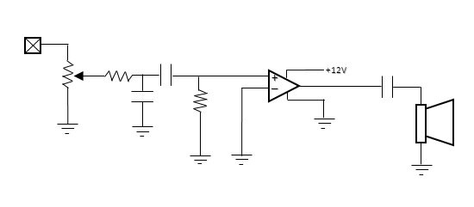
Circuit
Headphone Speaker
LM380 operational amplifier used
Potentiometer used to select the most suitable gain
Notes:
Potentiometer adds flexibility

Slide 11
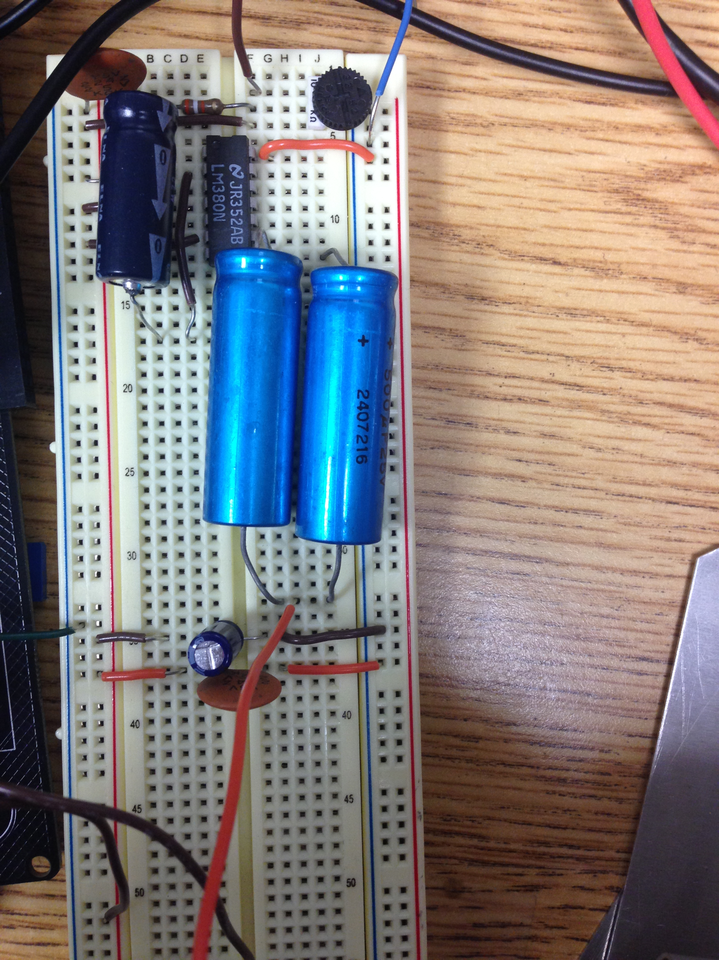
Speaker Specs
Headphone Speaker
Power rating – 4W
Impedance – 4 Ohms
Frequency range – 100 to 20,000Hz

Slide 12
PSoC Creator

Slide 13
What is PSoC?
PSoC Creator
PSoC is a family of microcontroller integrated circuits
Includes a CPU core, mixed signal arrays of integrated analog and digital peripherals
Using PSoC 5LP in this Project
32-bit ARM Cortex-M3 up to 67MHz, 84MIPS
Flash Memory of 32KB-256KB and Stored RAM of 8KB to 64KB
Operates from 2.7V to 5.5V
Avoids use of custom circuit boards
Notes:
Bullet point #2 – We deal with both Analog and Digital arrays but mostly anlog than digital
#5 – Show how much data can be stored
Flash- how big of a program you can write (not a limitation)
SRAM- limitation because it’s the amount of data you can store

Slide 14
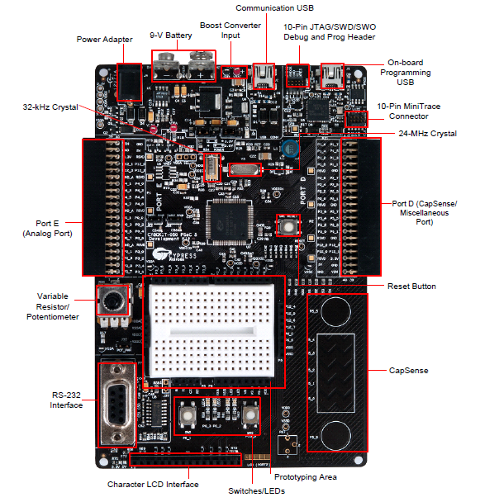
What is PSoC?
PSoC Creator
Notes:
Mention that this is used in many classes.

Slide 15
How did I use PSoC?
PSoC Creator
PSoC was used to output a generated sin wave via the speaker
2 sin waves – HS model and LS Model
Code in PSoC does the adaptive cancelling
3 Modes included
Basic look at the sine wave
Analyzing a random sequence
Adaptive canceller
Notes:
Go into detail for bullet point 2
#4 #1 – Use it to analyze the sin wave, make sure that its not to stairsteppy and it’s a nice smooth wave
#4 #2 – Use it to record random sequence ad transfer it to a PC for further analysis. (Julie)
#4 #3 – Adaptive noise canceller

Slide 16
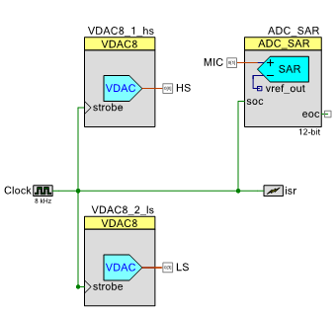
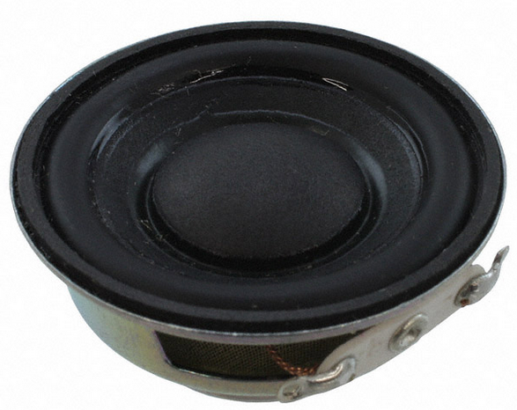
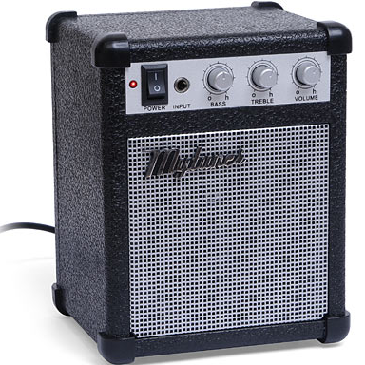
Schematic
How did I use PSoC?
Notes:
Go into detail
Explain the isr.
8kHz clock->connected to everything and isr
ISR-> tells psoc that on the rising edge of the clock it will cause an interrupt
Which means that
Everytime that happens ISR_Interrupt is called upon. All of the interesting stuff like (canceller etc) is called upon

Slide 17
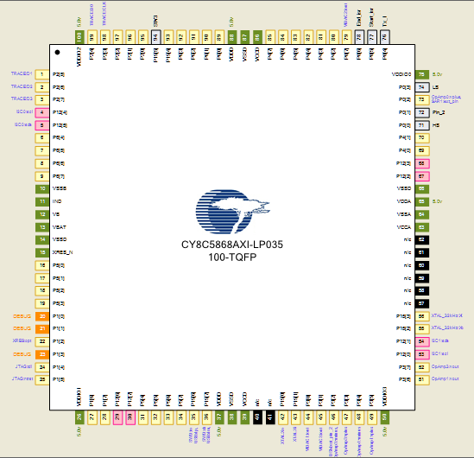
Pin Assignments
How did I use PSoC?

Slide 18
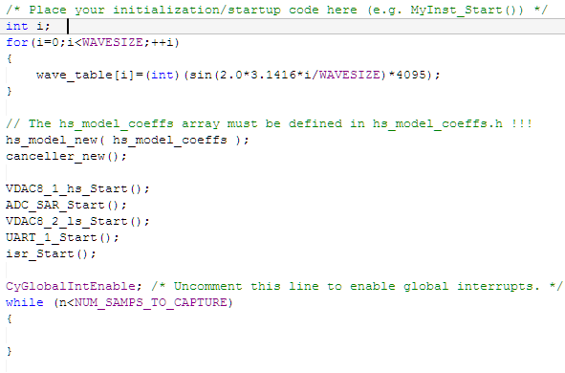
Code
How did I use PSoC?
Sin wave generator
canceller
Start up

Slide 19
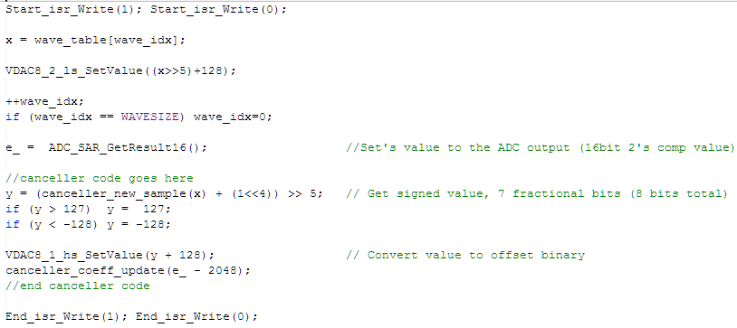
Code
How did I use PSoC?

Slide 20
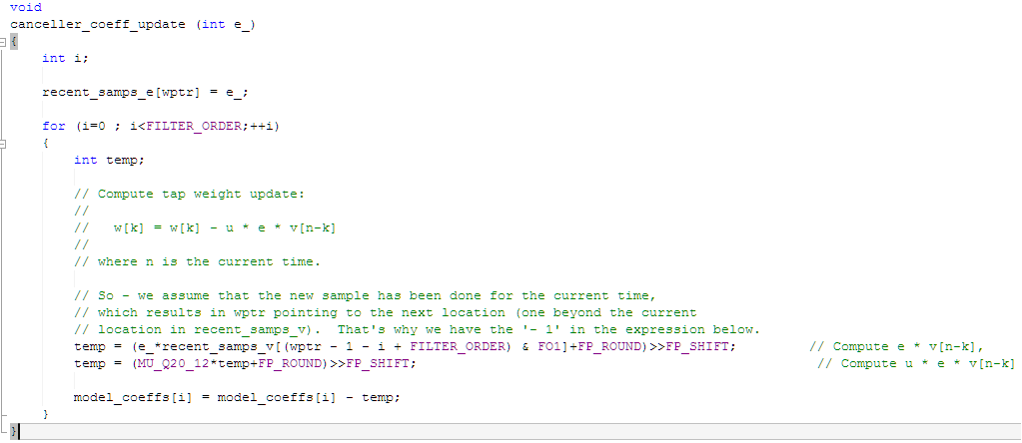
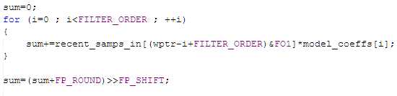
Code
How did I use PSoC?
LMS algorithm
Runs whenever
A new sample
Is received
∑e^2 (n) = Ʃ (d(n) - w ⃑^( t)* x ⃑(n))^2
Notes:
LMS algorithm
New sample runs everytime it receives a new sample (2nd curly)

Slide 21
PSoC Performance
How did I use PSoC?
Convenient way of looking at the performance
Compares sampling rate (frequency) with number of taps
Notes:
Shows for a certain number of taps what is the maximum sampling rate we can have (vice versa)
Taps – it is the length of the impulse response of the of the filter

Slide 22
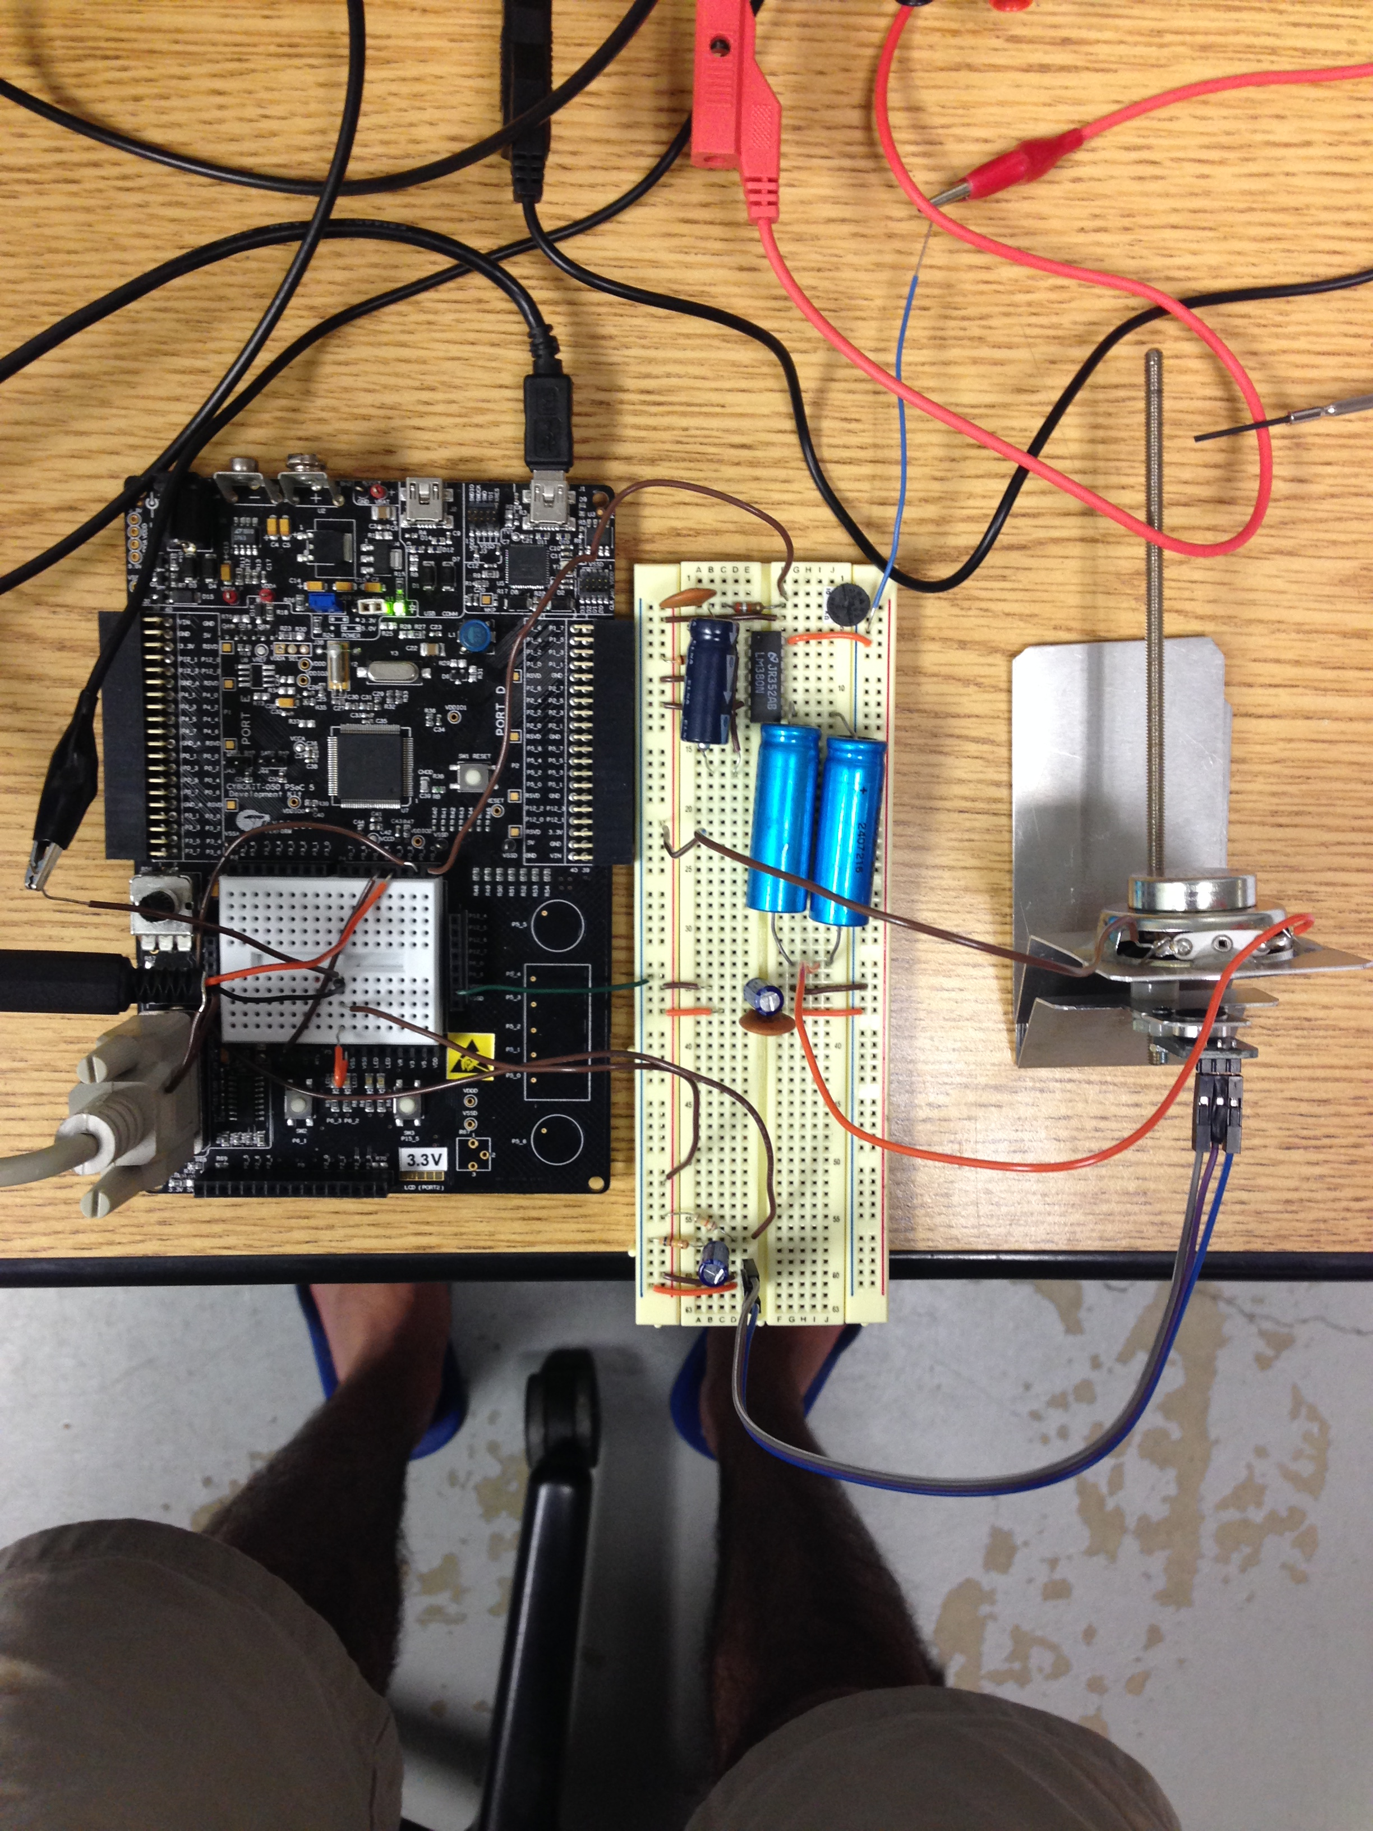
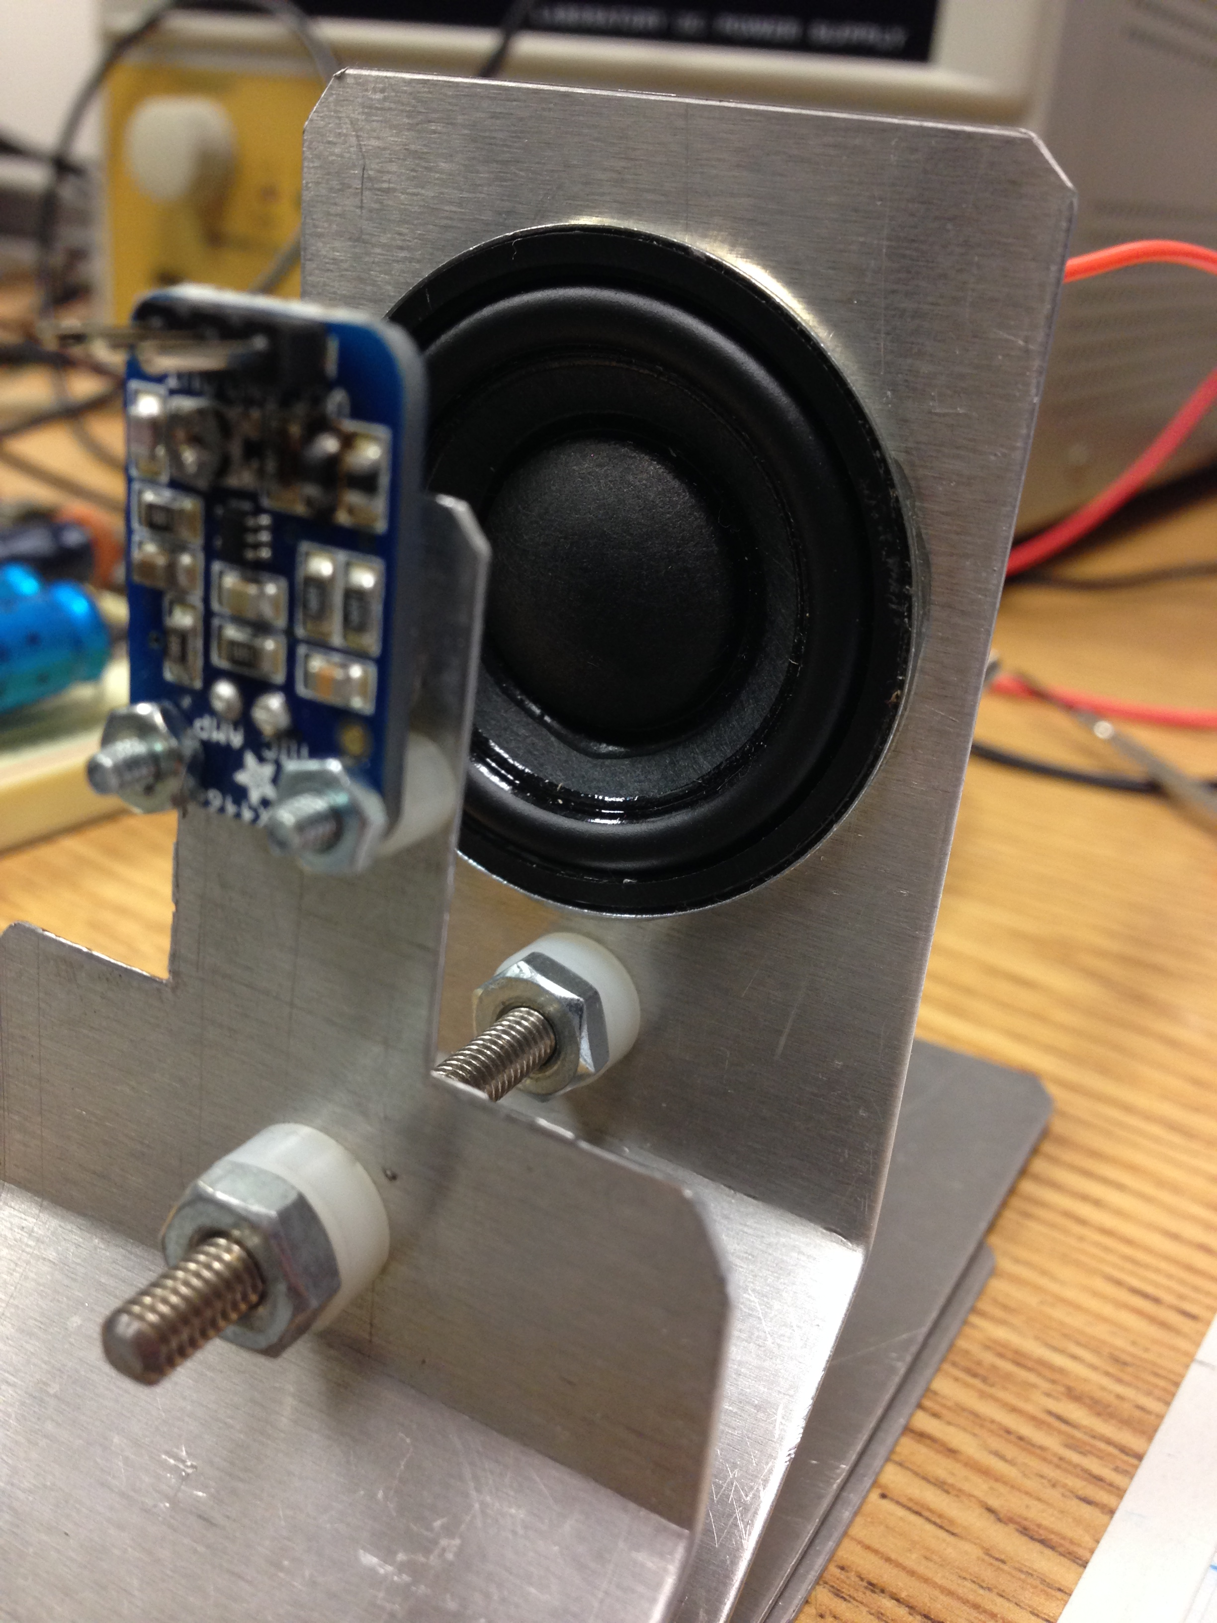
Final system picture

Slide 23
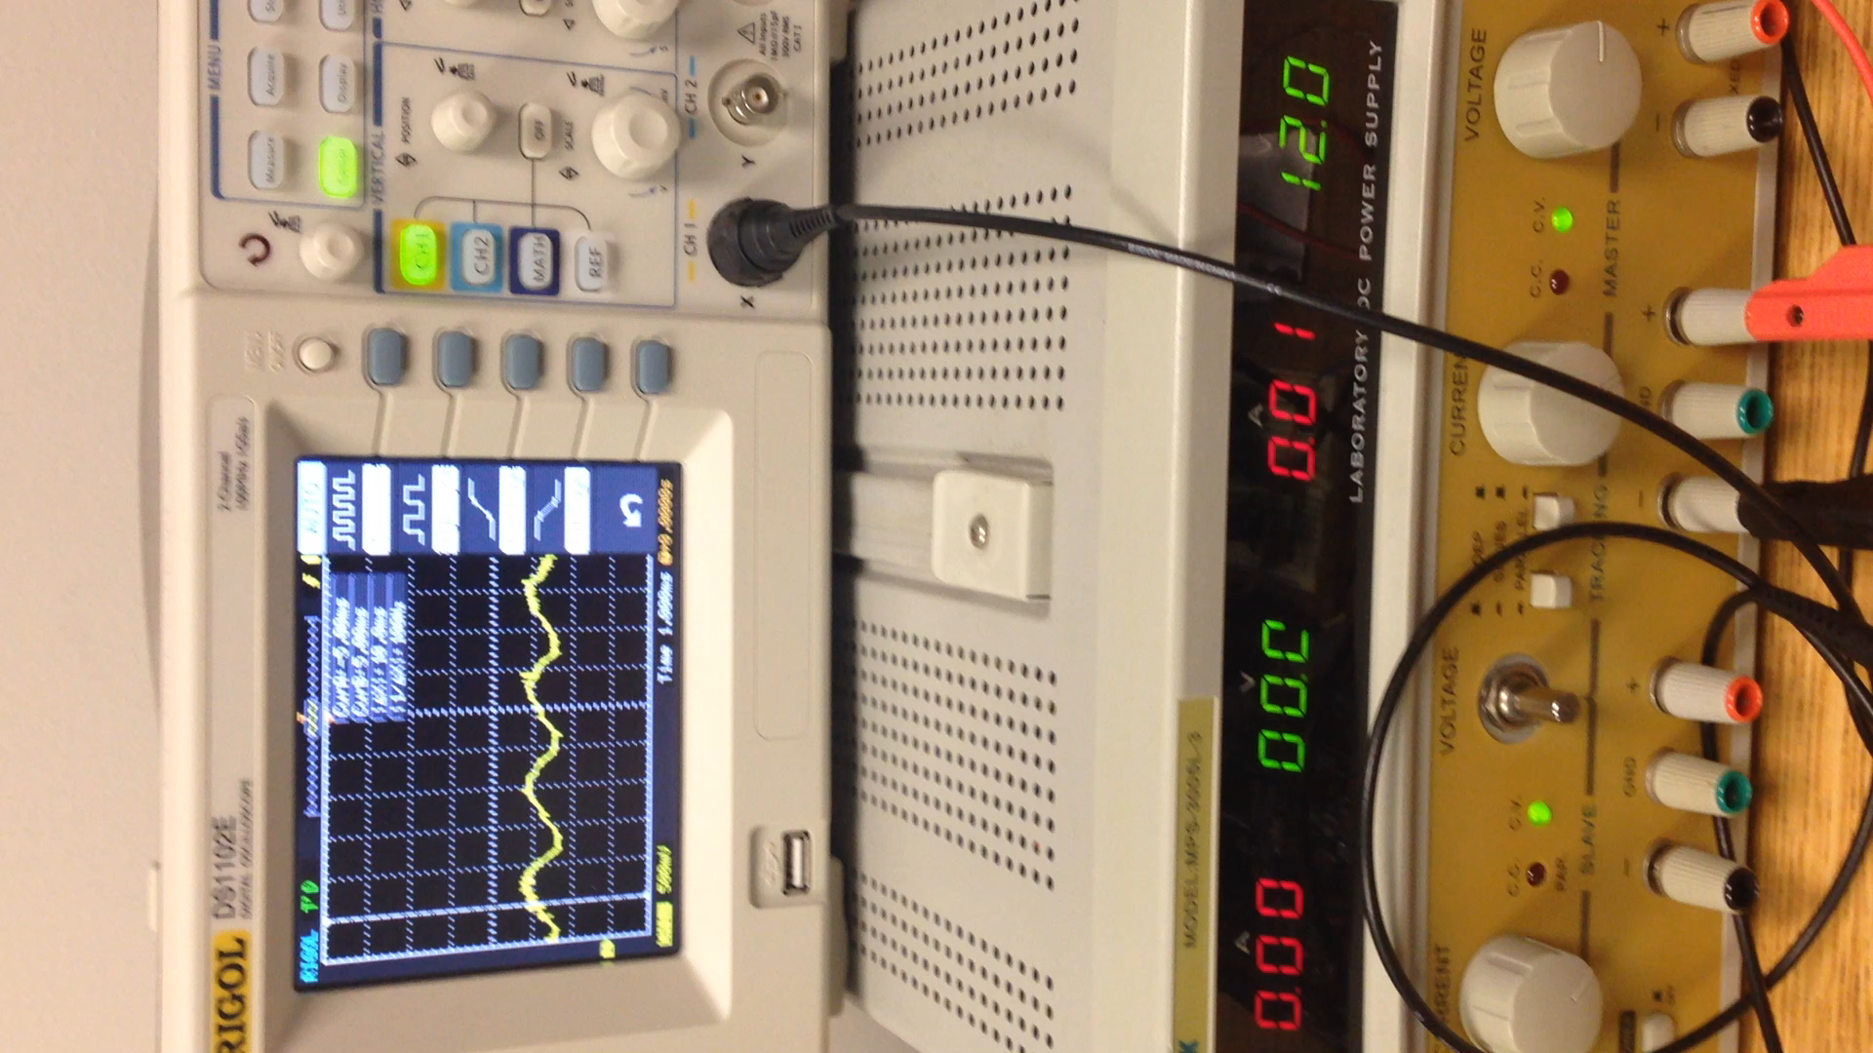
Demo

Slide 24
Conclusion and Future Work
Conclusion
Achieved goal for the summer
*PSoC isn’t powerful enough
Challenges faced include
Too much noise
Future Work
Trying to find an alternative for PsoC
Would like to go from an analog circuit to a digital circuit
Reduces noise
Notes:
Bullet point #1 – successfully cancelled out the sin wave
#3 #1 – Analog signal that’s why. Hard to read the waves some times

Slide 25
References
[WID1975] Widrow, Bernard, et al. "Adaptive noise cancelling: Principles and applications."Proceedings of the IEEE 63.12 (1975): 1692-1716.
[KAJ2012] Kajikawa, Yoshinobu, Woon-Seng Gan, and Sen M. Kuo. "Recent advances on active noise control: open issues and innovative applications." APSIPA Transactions on Signal and Information Processing 1 (2012): e3
[MOR1980] Morgan, Dennis R. "An analysis of multiple correlation cancellation loops with a filter in the auxiliary path." Acoustics, Speech and Signal Processing, IEEE Transactions on 28.4 (1980): 454-467.
[RAM2008] Ramachandran, Venkat R., Issa Panahi, and Eduardo Perez. "Active reduction of high-level acoustic noise on a fMRI test-bed using labview and FPGA platforms." Acoustics, Speech and Signal Processing, 2008. ICASSP 2008. IEEE International Conference on. IEEE, 2008.
[KAS2013] Rutger Kastby, Claes. "Active control for adaptive sound zones in passenger train compartments." (2013).
[GEO2013] George, Nithin V., and Ganapati Panda. "Advances in active noise control: A survey, with emphasis on recent nonlinear techniques." Signal processing 93.2
[SAL2014] Salmasi, Mehrshad, and Homayoun Mahdavi-Nasab. "Evaluation of Neural Networks Performance in Active Cancellation of Acoustic Noise." Majlesi Journal of Electrical Engineering 8.4 (2014): 1-7.

Slide 26
Questions?

